Slide 1
Discrete Mathematics
Unit 1
1
Logic and proofs

Slide 2
Propositions
A proposition is a declarative sentence (that is, a sentence that declares a fact) that is either true
or false, but not both.
EXAMPLE 1 All the following declarative sentences are propositions.
1. Kathmandu., is the capital of the Nepal.
2. Toronto is the capital of Canada.
3. 1 + 1 = 2.
4. 2 + 2 = 3.
Propositions 1 and 3 are true, whereas 2 and 4 are false.
Some sentences that are not propositions
EXAMPLE 2 Consider the following sentences.
1. What time is it?
2. Read this carefully.
3. x + 1 = 2.
4. x + y = z.
Sentences 1 and 2 are not propositions because they are not declarative sentences. Sentences 3
and 4 are not propositions because they are neither true nor false.

Slide 3
To represent propositions, propositional variables are used.
By Convention, these variables are represented by small alphabets such as p, q, r, s .
The area of logic which deals with propositions is called propositional calculus or propositional logic.
Propositions constructed using one or more propositions are called compound propositions.
The propositions are combined together using Logical Connectives or Logical Operators.

Slide 4
Constructing Propositions
Propositional Variables: p, q, r, s, …
The proposition that is always true is denoted by T and the proposition that is always false is denoted by F.
Compound Propositions; constructed from logical connectives and other propositions
Negation ¬
Conjunction ∧
Disjunction ∨
Implication →
Biconditional ↔

Slide 5
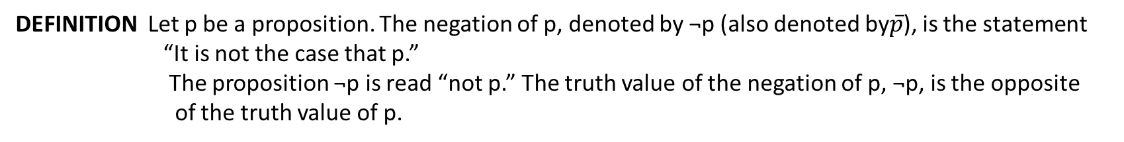
DEFINITION Let p be a proposition. The negation of p, denoted by ¬p (also denoted by$\overline{p}$), is the statement
“It is not the case that p.”
The proposition ¬p is read “not p.” The truth value of the negation of p, ¬p, is the opposite
of the truth value of p.
EXAMPLE: Find the negation of the proposition
“Vandana’s smartphone has at least 32GB of memory”
Solution: The negation is “Vandana’s smartphone does not have at least 32GB of memory”
or even more simply as
“Vandana’s smartphone has less than 32GB of memory.”
Example: If p denotes “The earth is round.”, then ¬p denotes “It is not the case that the earth is round,” or more simply “The earth is not round.”
The truth table for the negation of a proposition p.
TABLE 1 The Truth Table for the Negation of a Proposition.
p | ¬p
T F | F T

Slide 6
DEFINITION Let p and q be propositions. The conjunction of p and q, denoted by p ∧ q, is the proposition
“p and q.” The conjunction p ∧ q is true when both p and q are true and is false otherwise.
The Truth Table for the Conjunction of Two Propositions.
P | q | p ∧ q
T T F F | T F T F | T F F F
Example: If p denotes “I am at home.” and q denotes “It is raining.” then p ∧q denotes “I am at home and it is raining.”
DEFINITION Let p and q be propositions. The disjunction of p and q, denoted by p ∨ q, is the proposition “p or q.”
The disjunction p ∨ q is false when both p and q are false and is true otherwise.
The Truth Table for the Disjunction of Two Propositions.
p | q | p ∨ q
T T F F | T F T F | T T T F

Slide 7
Example: If p denotes “I am at home.” and q denotes “It is raining.” then p ∨q denotes “I am at home or it is raining.”
DEFINITION Let p and q be propositions. The exclusive or of p and q, denoted by p ⊕ q, is the proposition
that is true when exactly one of p and q is true and is false otherwise.
The Truth Table for the Exclusive Or of Two Propositions.
p | q | p ⊕ q
T T F F | T F T F | F T T F

Slide 8
Conditional Statements
DEFINITION Let p and q be propositions. The conditional statement p → q is the proposition “if p, then q.” The conditional
statement p → q is false when p is true and q is false, and true otherwise. In the conditional statement p → q,
p is called the hypothesis (or antecedent or premise) and q is called the conclusion (or consequence).
The Truth Table for the Conditional Statement p → q.
p | q | p → q
T T F F | T F T F | T F T T
Example:
“If I am elected, then I will lower taxes.”
“If you get 100% on the final, then you will get an A.”
“If 1 + 1 = 3, then 2 + 3 = 6.

Slide 9
Different Ways of Expressing p →q
if p, then q p implies q
if p, q p only if q
q unless ¬p q when p
q if p
q whenever p p is sufficient for q
q follows from p q is necessary for p
a necessary condition for p is q
a sufficient condition for q is p

Slide 10
CONVERSE, CONTRAPOSITIVE, AND INVERSE
We can form some new conditional statements starting with a conditional statement p → q. In particular, there are three related conditional statements that occur so often that they have special names.
The proposition q → p is called the converse of p → q.
The proposition ¬q → ¬p is called the contrapositive of p → q.
The proposition ¬p → ¬q is called the inverse of p → q.
Example: Find the converse, inverse, and contrapositive of “It raining is a sufficient condition for my not going to town.”
Solution:
converse:
If I do not go to town, then it is raining.
If it is not raining, then I will go to town.
inverse:
contrapositive:
If I go to town, then it is not raining.

Slide 11
BICONDITIONALS
DEFINITION Let p and q be propositions. The biconditional statement p ↔ q is the proposition “p if
and only if q.” The biconditional statement p ↔ q is true when p and q have the same truth
values, and is false otherwise. Biconditional statements are also called bi-implications.
the biconditional statement p ↔ q uses the abbreviation “iff” for
“if and only if.” Note that p ↔ q has exactly the same truth value as (p → q) ∧ (q → p).
The Truth Table for the Biconditional p ↔ q.
p | q | p ↔ q
T T F F | T F T F | T F F T
Example: If p denotes “I am at home.” and q denotes “It is raining.” then p ↔q denotes “I am at
home if and only if it is raining.”

Slide 12
Expressing the Biconditional
Some alternative ways “p if and only if q” is expressed in English:
p is necessary and sufficient for q
if p then q , and conversely
p iff q

Slide 13
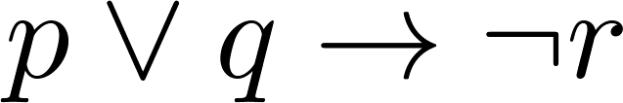
Example Truth Table
Construct a truth table for
p | q | r | ¬r | p ∨ q | p ∨ q → ¬r
T | T | T | F | T | F
T | T | F | T | T | T
T | F | T | F | T | F
T | F | F | T | T | T
F | T | T | F | T | F
F | T | F | T | T | T
F | F | T | F | F | T
F | F | F | T | F | T

Slide 14
Equivalent Propositions
Two propositions are equivalent if they always have the same truth value.
Example: Show using a truth table that the conditional is equivalent to the contrapositive.
Solution:
p | q | ¬ p | ¬ q | p →q | ¬q → ¬ p
T | T | F | F | T | T
T | F | F | T | F | F
F | T | T | F | T | T
F | F | T | T | T | T
Thus, p →q ≡ ¬q → ¬ p

Slide 15
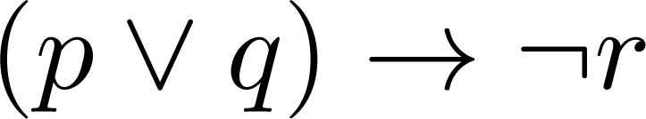
Translating English Sentences
Steps to convert an English sentence to a statement in propositional logic
Identify atomic propositions and represent using propositional variables.
Determine appropriate logical connectives
“If I go to Harry’s or to the country, I will not go shopping.”
p: I go to Harry’s
q: I go to the country.
r: I will go shopping.
If p or q then not r.

Slide 16
Example
Translate the following sentence into propositional logic:
“You can access the Internet from campus only if you are a computer science major or you are not a freshman.”
Solution: Let p, q, and r represent respectively “You can access the internet from campus,” “You are a computer science major,” and “You are a freshman.”
p→ (q ∨ ¬ r)
Example: Express in propositional logic:
“The automated reply cannot be sent when the file system is full”
Solution: One possible solution: Let p denote “The automated reply
can be sent” and q denote “The file system is full.”
q→ ¬ p

Slide 17
Tautologies, Contradictions, and Contingencies
A tautology is a proposition which is always true.
Example: p ∨¬p
A contradiction is a proposition which is always false.
Example: p ∧¬p
A contingency is a proposition which is neither a tautology nor a contradiction, such as p
P | ¬p | p ∨¬p | p ∧¬p
T | F | T | F
F | T | T | F

Slide 18
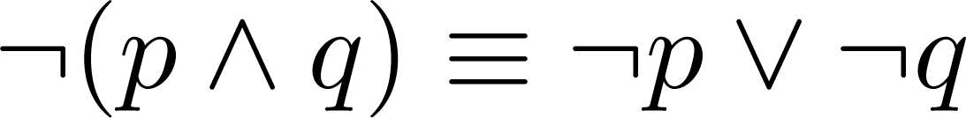
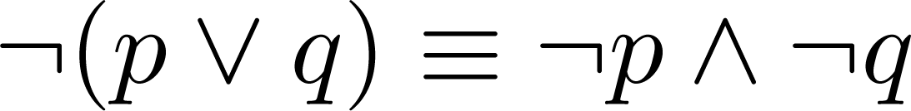
De Morgan’s Laws
This truth table shows that De Morgan’s Second Law holds.
p | q | ¬p | ¬q | (p∨q) | ¬(p∨q) | ¬p∧¬q
T | T | F | F | T | F | F
T | F | F | T | T | F | F
F | T | T | F | T | F | F
F | F | T | T | F | T | T

Slide 19
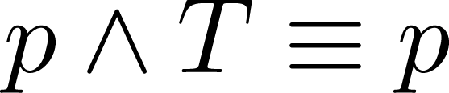
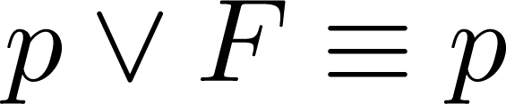
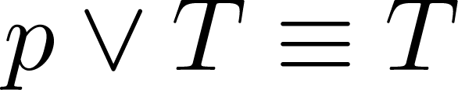
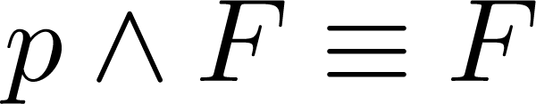
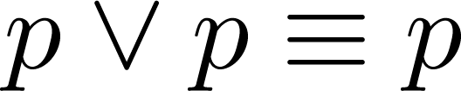
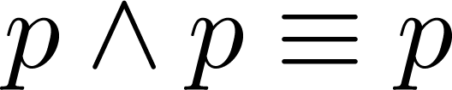
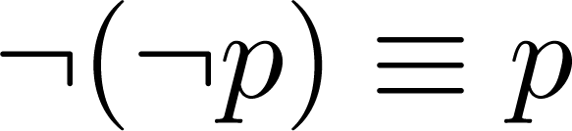
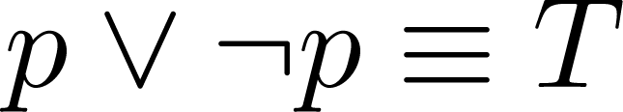
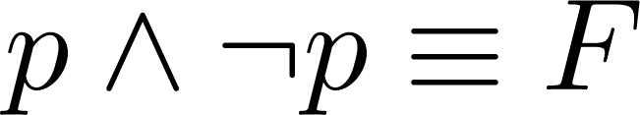
Identity Laws: ,
Domination Laws: ,
Idempotent laws: ,
Double Negation Law:
Negation Laws: ,

Slide 20
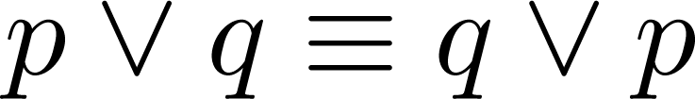
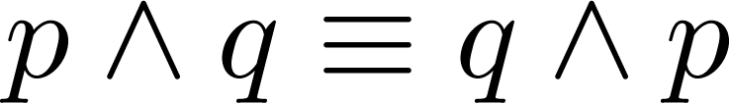
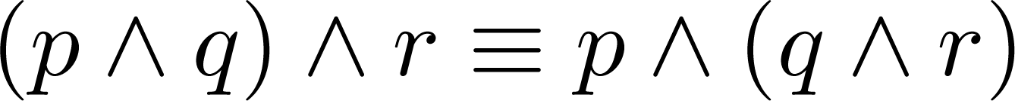
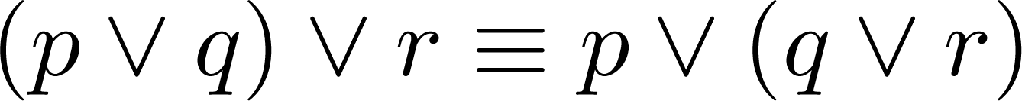
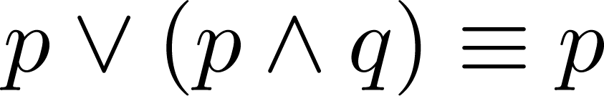
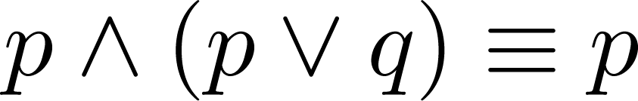
Commutative Laws: ,
Associative Laws:
Distributive Laws:
Absorption Laws:

Slide 21
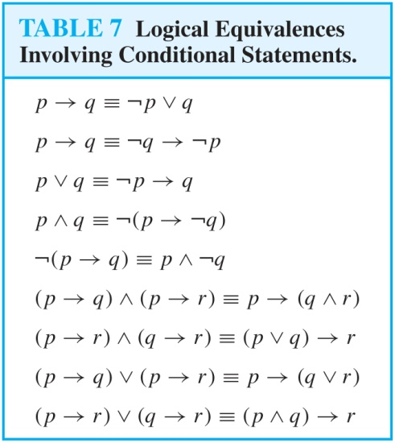
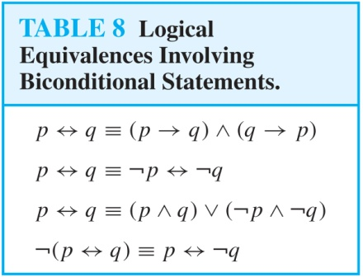

Slide 22
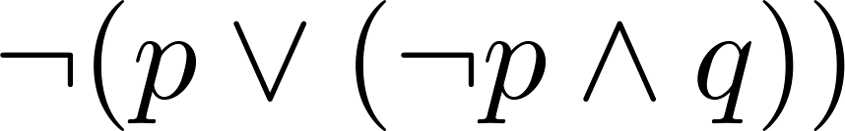
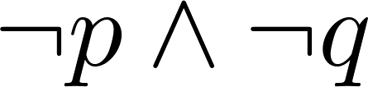
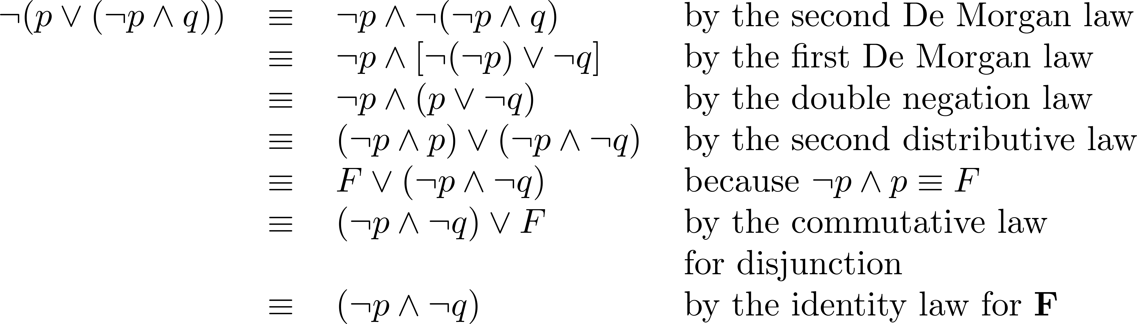
Example: Show that
is logically equivalent to
Solution:

Slide 23
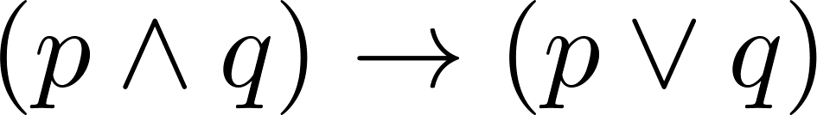
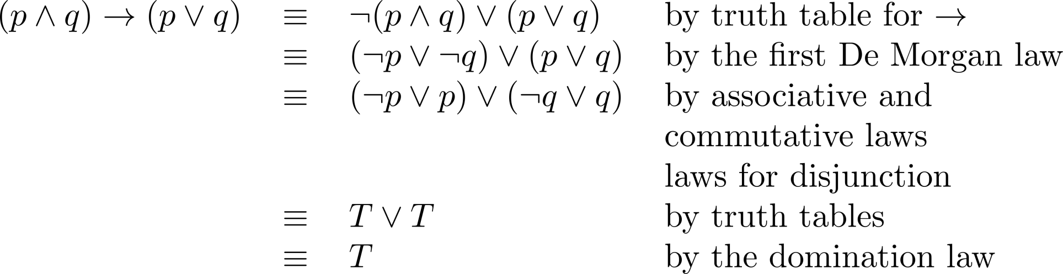
Example: Show that
is a tautology.
Solution:

Slide 24
Section Summary
Predicates
Variables
Quantifiers
Universal Quantifier
Existential Quantifier
Negating Quantifiers
De Morgan’s Laws for Quantifiers
Translating English to Logic
Logic Programming (optional)

Slide 25
Predicate and Quantifier
Propositional logic is not enough to express the meaning of all statements in mathematics and natural language.
Example:
Is x > 1 true or false ?
Is ‘ x ‘ is great tennis player, true or false ?
What is a predicate?
Consider the statement, “x is greater than 3″. It has two parts. The first part, the variable x, is the subject of the statement. The second part, “is greater than 3”, is the predicate. It refers to a property that the subject of the statement can have.
The statement “x is greater than 3″ can be denoted by P(x) where P denotes the predicate “is greater than 3” and x is the variable.
The predicate P can be considered as a function. It tells the truth value of the statement P(x) at x. Once a value has been assigned to the variable x, the statement P(x) becomes a proposition and has a truth(T) or false(F) value.

Slide 26
Example 1: Let P(x) denote the statement “x > 10″. What are the truth values of P(11) and P(5)?
Solution:
P(11) is equivalent to the statement 11 > 10, which is True.
P(5) is equivalent to the statement 5 > 10, which is False.
Example 2: Let R(x, y) denote the statement “x = y + 1“. What is the truth value of the propositions R(1,3) and R(2,1)?
Solution:
R(1,3) is the statement 1 = 3 + 1, which is False.
R(2,1) is the statement 2 = 1 + 1, which is True.
Introducing Predicate Logic
Predicate logic uses the following new features:
Variables: x, y, z
Predicates: P(x), M(x)

Slide 27
Propositional Functions
Propositional functions become propositions (and have truth values) when their variables are each replaced by a value from the domain (or bound by a quantifier, as we will see later).
The statement P(x) is said to be the value of the propositional function P at x.
For example, let P(x) denote “x > 0” and the domain be the integers. Then:
P(-3) is false.
P(0) is false.
P(3) is true.
Examples of Propositional Functions
Let “x + y = z” be denoted by R(x, y, z) and U (for all three variables) be the integers. Find these truth values:
R(2,-1,5)
Solution: F
R(3,4,7)
Solution: T
R(x, 3, z)
Solution: Not a Proposition

Slide 28
Now let “x - y = z” be denoted by Q(x, y, z), with U as the integers. Find these truth values:
Q(2,-1,3)
Solution: T
Q(3,4,7)
Solution: F
Q(x, 3, z)
Solution: Not a Proposition
Compound Expressions
Connectives from propositional logic carry over to predicate logic.
If P(x) denotes “x > 0,” find these truth values:
P(3) ∨ P(-1) Solution: T
P(3) ∧ P(-1) Solution: F
P(3) → P(-1) Solution: F
P(3) → ¬P(-1) Solution: T
Expressions with variables are not propositions and therefore do not have truth values.
For example, P(3) ∧ P(y)
P(x) → P(y)

Slide 29
Quantifiers
We need quantifiers to express the meaning of English words including all and some:
“All men are Mortal.”
“Some cats do not have fur.”
The two most important quantifiers are:
Universal Quantifier, “For all,” symbol: ∀
Existential Quantifier, “There exists,” symbol: ∃
We write as in ∀x P(x) and ∃ x P(x).
∀x P(x) asserts P(x) is true for every x in the domain.
∃x P(x) asserts P(x) is true for some x in the domain.

Slide 30
Universal Quantifier
∀x P(x) is read as “For all x, P(x)” or “For every x, P(x)”
Examples:
If P(x) denotes “x > 0” and U is the integers, then ∀x P(x) is false.
If P(x) denotes “x > 0” and U is the positive integers, then ∀x P(x) is true.
If P(x) denotes “x is even” and U is the integers, then ∀ x P(x) is false.
Existential Quantifier
∃x P(x) is read as “For some x, P(x)”, or as “There is an x such that P(x),” or “For at least one x, P(x).”
Examples:
If P(x) denotes “x > 0” and U is the integers, then ∃x P(x) is true. It is also true if U is the positive integers.
If P(x) denotes “x < 0” and U is the positive integers, then ∃x P(x) is false.
If P(x) denotes “x is even” and U is the integers, then ∃x P(x) is true.

Slide 31
Uniqueness Quantifier (optional)
∃!x P(x) means that P(x) is true for one and only one x in the universe of discourse.
This is commonly expressed in English in the following equivalent ways:
“There is a unique x such that P(x).”
“There is one and only one x such that P(x)”
Examples:
If P(x) denotes “x + 1 = 0” and U is the integers, then ∃!x P(x) is true.
But if P(x) denotes “x > 0,” then ∃!x P(x) is false.
Properties of Quantifiers
The truth value of ∃x P(x) and ∀ x P(x) depend on both the propositional function P(x) and on the domain U.
Examples:
If U is the positive integers and P(x) is the statement “x < 2”, then ∃x P(x) is true, but ∀ x P(x) is false.
If U is the negative integers and P(x) is the statement “x < 2”, then both ∃x P(x) and ∀ x P(x) are true.
If U consists of 3, 4, and 5, and P(x) is the statement “x > 2”, then both ∃x P(x) and ∀ x P(x) are true. But if P(x) is the statement “x < 2”, then both ∃x P(x) and ∀ x P(x) are false.

Slide 32
Precedence of Quantifiers
The quantifiers ∀ and ∃ have higher precedence than all the logical operators.
For example, ∀x P(x) ∨ Q(x) means (∀x P(x))∨ Q(x)
∀x (P(x) ∨ Q(x)) means something different.
Unfortunately, often people write ∀x P(x) ∨ Q(x) when they mean ∀ x (P(x) ∨ Q(x)).
Translating from English to Logic
Example 1: Translate the following sentence into predicate logic: “Every student in this class has taken a course in Java.”
Solution:
First decide on the domain U.
Solution 1: If U is all students in this class, define a propositional function J(x) denoting “x has taken a course in Java” and translate as ∀x J(x).
Solution 2: But if U is all people, also define a propositional function S(x) denoting “x is a student in this class” and translate as ∀x (S(x)→ J(x)).
“For every person x, if person x is a student in this class then x has taken java.”
If S(x) represents the statement that person x is in this class, we see that our statement can be expressed as
∀x(S(x) → C(x)).

Slide 33
Example 2: Translate the following sentence into predicate logic: “Some student in this class has taken a course in Java.”
Solution:
First decide on the domain U.
Solution 1: If U is all students in this class, translate as ∃x J(x)
Solution 2: But if U is all people, then translate as ∃x (S(x) ∧ J(x))
Our solution becomes ∃x(S(x) ∧ J(x)) because the statement is that there is a person x who is a student in this class and who has taken a Java.
∃x (S(x)→ J(x)) is not correct. What does it mean?
[Caution! Our statement cannot be expressed as ∃x(S(x) → J(x)), which is true when there is someone not in the class because, in that case, for such a person x, S(x) → J(x) becomes either F → T or F → F, both of which are true.]

Slide 34
Equivalences in Predicate Logic
Statements involving predicates and quantifiers are logically equivalent if and only if they have the same truth value
for every predicate substituted into these statements and
for every domain of discourse used for the variables in the expressions.
The notation S ≡T indicates that S and T are logically equivalent.
Example: ∀x ¬¬S(x) ≡ ∀x S(x)
Thinking about Quantifiers as Conjunctions and Disjunctions
If the domain is finite, a universally quantified proposition is equivalent to a conjunction of propositions without quantifiers and an existentially quantified proposition is equivalent to a disjunction of propositions without quantifiers.
If U consists of the integers 1,2, and 3:
Even if the domains are infinite, you can still think of the quantifiers in this fashion, but the equivalent expressions without quantifiers will be infinitely long.

Slide 35
Negating Quantified Expressions
Consider ∀x J(x)
“Every student in your class has taken a course in Java.”
Here J(x) is “x has taken a course in Java” and
the domain is students in your class.
Negating the original statement gives “It is not the case that every student in your class has taken Java.” This implies that “There is a student in your class who has not taken Java.”
Symbolically ¬∀x J(x) and ∃x ¬J(x) are equivalent
Now Consider ∃ x J(x)
“There is a student in this class who has taken a course in Java.”
Where J(x) is “x has taken a course in Java.”
Negating the original statement gives “It is not the case that there is a student in this class who has taken Java.” This implies that “Every student in this class has not taken Java”
Symbolically ¬∃ x J(x) and ∀ x ¬J(x) are equivalent

Slide 36
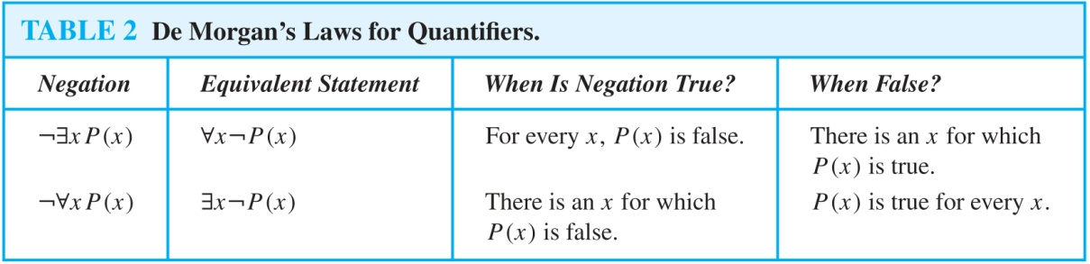
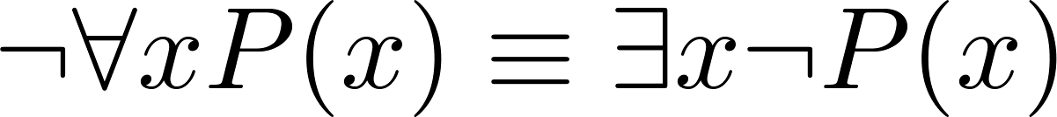
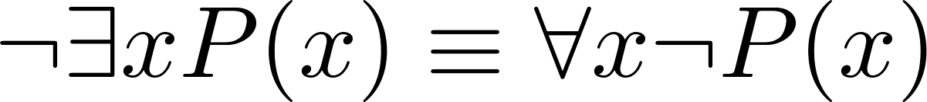
De Morgan’s Laws for Quantifiers
The rules for negating quantifiers are:
The reasoning in the table shows that:
These are important. You will use these.

Slide 37
Translation from English to Logic
Examples:
“Some student in this class has visited Mexico.”
Solution: Let M(x) denote “x has visited Mexico” and S(x) denote “x is a student in this class,” and U be all people.
∃x (S(x) ∧ M(x))
“Every student in this class has visited Canada or Mexico.”
Solution: Add C(x) denoting “x has visited Canada.”
∀x (S(x)→ (M(x)∨C(x)))

Slide 38
Some Fun with Translating from English into Logical Expressions
U = {fleegles, snurds, thingamabobs}
F(x): x is a fleegle
S(x): x is a snurd
T(x): x is a thingamabob
Translate “Everything is a fleegle”
Solution: ∀x F(x)

Slide 39
U = {fleegles, snurds, thingamabobs}
F(x): x is a fleegle
S(x): x is a snurd
T(x): x is a thingamabob
“Nothing is a snurd.”
Solution: ¬∃x S(x) What is this equivalent to?
Solution: ∀x ¬ S(x)

Slide 40
U = {fleegles, snurds, thingamabobs}
F(x): x is a fleegle
S(x): x is a snurd
T(x): x is a thingamabob
“All fleegles are snurds.”
Solution: ∀x (F(x)→ S(x))

Slide 41
U = {fleegles, snurds, thingamabobs}
F(x): x is a fleegle
S(x): x is a snurd
T(x): x is a thingamabob
“Some fleegles are thingamabobs.”
Solution: ∃x (F(x) ∧ T(x))

Slide 42
U = {fleegles, snurds, thingamabobs}
F(x): x is a fleegle
S(x): x is a snurd
T(x): x is a thingamabob
“No snurd is a thingamabob.”
Solution: ¬∃x (S(x) ∧ T(x)) What is this equivalent to?
Solution: ∀x (¬S(x) ∨ ¬T(x))

Slide 43
U = {fleegles, snurds, thingamabobs}
F(x): x is a fleegle
S(x): x is a snurd
T(x): x is a thingamabob
“If any fleegle is a snurd then it is also a thingamabob.”
Solution: ∀x ((F(x) ∧ S(x))→ T(x))

Slide 44
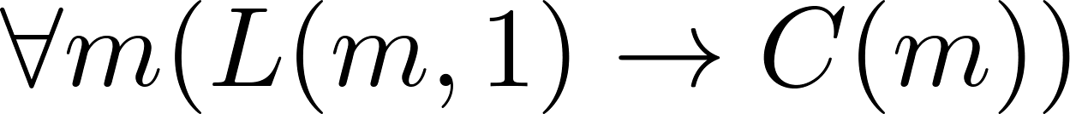
Predicate logic is used for specifying properties that systems must satisfy.
For example, translate into predicate logic:
“Every mail message larger than one megabyte will be compressed.”
“If a user is active, at least one network link will be available.”
Decide on predicates and domains (left implicit here) for the variables:
Let L(m, y) be “Mail message m is larger than y megabytes.”
Let C(m) denote “Mail message m will be compressed.”
Let A(u) represent “User u is active.”
Let S(n, x) represent “Network link n is state x.
Now we have:

Slide 45
The first two are called premises and the third is called the conclusion.
“All lions are fierce.”
“Some lions do not drink coffee.”
“Some fierce creatures do not drink coffee.”
Here is one way to translate these statements to predicate logic. Let P(x), Q(x), and R(x) be the propositional functions “x is a lion,” “x is fierce,” and “x drinks coffee,” respectively.
∀x (P(x)→ Q(x))
∃x (P(x) ∧ ¬R(x))
∃x (Q(x) ∧ ¬R(x))
Later we will see how to prove that the conclusion follows from the premises.

Slide 46
Summary
Valid Arguments and Rules of Inference
Proof Methods
Proof Strategies

Slide 47
Rules of Inference
Section Summary
Valid Arguments
Inference Rules for Propositional Logic
Using Rules of Inference to Build Arguments
Rules of Inference for Quantified Statements
Building Arguments for Quantified Statements

Slide 48
Arguments in Propositional Logic
A argument in propositional logic is a sequence of propositions. All but the final proposition are called premises. The last statement is the conclusion.
The argument is valid if the premises imply the conclusion. An argument form is an argument that is valid no matter what propositions are substituted into its propositional variables.
If the premises are p₁ ,p₂, …,p_{n} and the conclusion is q then
(p₁ ∧ p₂ ∧ … ∧ p_{n} ) → q is a tautology.
Inference rules are all argument simple argument forms that will be used to construct more complex argument forms.

Slide 49
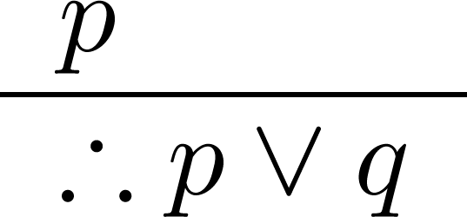
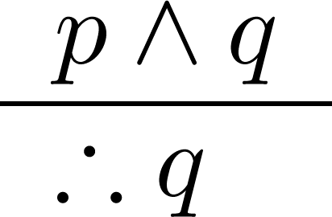
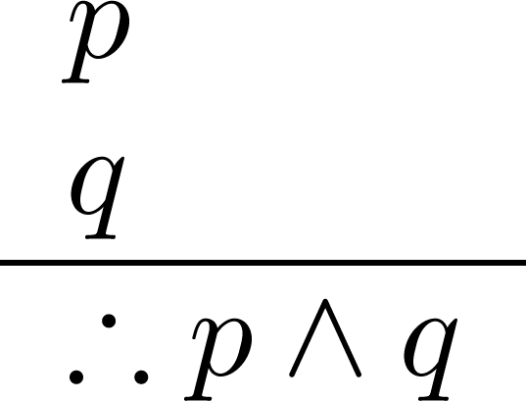
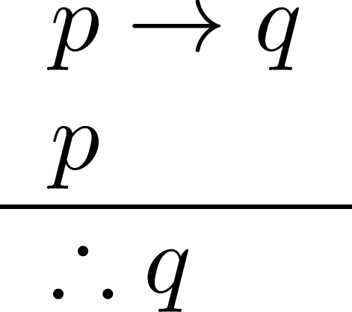
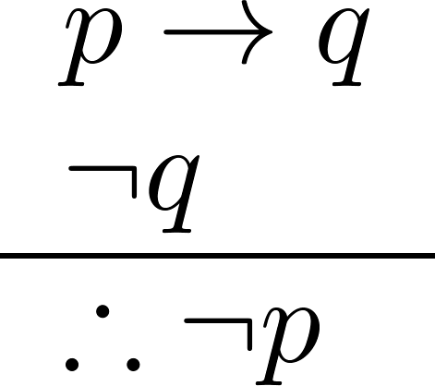
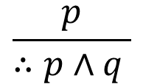
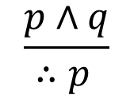
Name
Rules of Inference
Name
$$\frac{p}{∴p∧q }$$
1. Addition
$$\frac{p∧q}{∴p }$$
2. Simplification
3. Conjunction
4. Modus Ponens
5. Modus Tollens

Slide 50
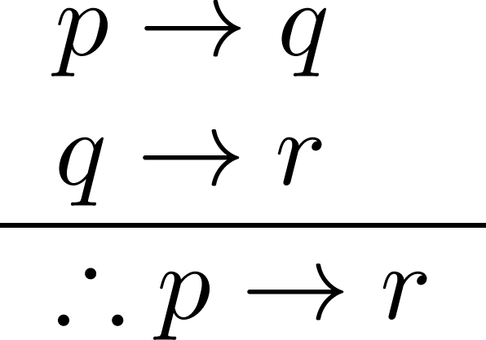
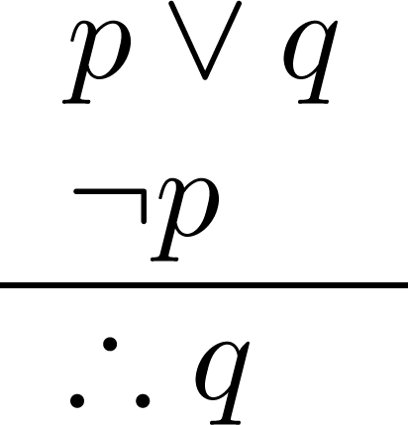
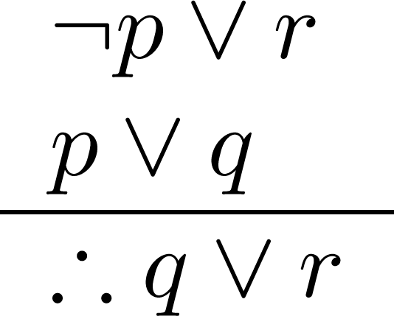
Name
Rules of Inference
6. Hypothetical Syllogism
7. Disjunctive Syllogism
8. Resolution

Slide 51
Addition
Example:
Let p be “I will study discrete math.”
Let q be “I will visit Pokhara.”
“I will study discrete math.”
“Therefore, I will study discrete math or I will visit
Pokhara.”
Corresponding Tautology:
p →(p ∨q)

Slide 52
Simplification
Example:
Let p be “I will study discrete math.”
Let q be “I will study English literature.”
“I will study discrete math and English literature”
“Therefore, I will study discrete math.”
Corresponding Tautology:
( p ∧ q) →p

Slide 53
Conjunction
Example:
Let p be “I will study discrete math.”
Let q be “I will study English literature.”
“I will study discrete math.”
“I will study English literature.”
“Therefore, I will study discrete math and I will study English literature.”
Corresponding Tautology:
((p) ∧ (q)) →(p ∧ q)

Slide 54
Modus Ponens
Example:
Let p be “It is snowing.”
Let q be “I will study discrete math.”
“If it is snowing, then I will study discrete math.”
“It is snowing.”
“Therefore , I will study discrete math.”
Corresponding Tautology:
(p ∧ (p →q)) → q

Slide 55
Modus Tollens
Example:
Let p be “it is snowing.”
Let q be “I will study discrete math.”
“If it is snowing, then I will study discrete math.”
“I will not study discrete math.”
“Therefore , it is not snowing.”
Corresponding Tautology:
(¬q∧(p →q))→¬p

Slide 56
Hypothetical Syllogism
Example:
Let p be “it snows.”
Let q be “I will study discrete math.”
Let r be “I will get an A.”
“If it snows, then I will study discrete math.”
“If I study discrete math, I will get an A.”
“Therefore , If it snows, I will get an A.”
Corresponding Tautology:
((p →q) ∧ (q→r))→(p→ r)

Slide 57
Disjunctive Syllogism
Example:
Let p be “I will study discrete math.”
Let q be “I will study English literature.”
“I will study discrete math or I will study English literature.”
“I will not study discrete math.”
“Therefore , I will study English literature.”
Corresponding Tautology:
(¬p∧(p ∨q))→q

Slide 58
Resolution
Example:
Let p be “I will study discrete math.”
Let r be “I will study English literature.”
Let q be “I will study databases.”
“I will not study discrete math or I will study English literature.”
“I will study discrete math or I will study databases.”
“Therefore, I will study databases or I will study English literature.”
Corresponding Tautology:
((¬p ∨ r ) ∧ (p ∨ q)) →(q ∨ r)

Slide 59

Using the Rules of Inference to Build Valid Arguments
A valid argument is a sequence of statements. Each statement is either a premise or follows from previous statements by rules of inference. The last statement is called conclusion.
A valid argument takes the following form:
S₁
S₂
.
.
.
S_{n}
C

Slide 60
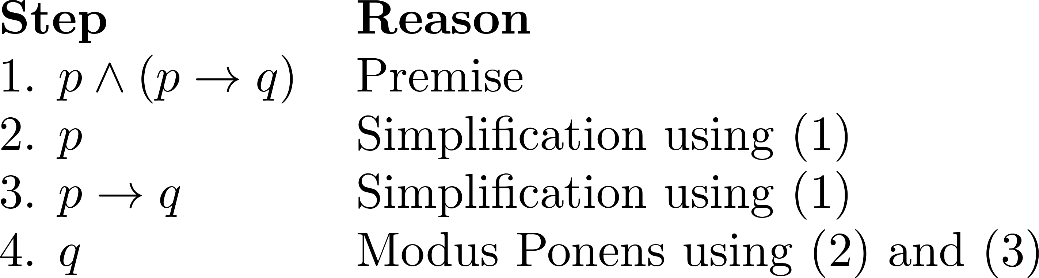
Valid Arguments
Example 1: From the single proposition
Show that q is a conclusion.
Solution:

Slide 61
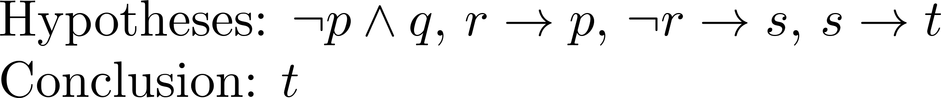
Valid Arguments
Example 2:
With these hypotheses:
“It is not sunny this afternoon and it is colder than yesterday.” “We will go swimming only if it is sunny.”
“If we do not go swimming, then we will take a canoe trip.”
“If we take a canoe trip, then we will be home by sunset.”
Using the inference rules, construct a valid argument for the conclusion:
“We will be home by sunset.”
Solution:
Choose propositional variables:
p : “It is sunny this afternoon.” r : “We will go swimming.” t : “We will be home by sunset.”
q : “It is colder than yesterday.” s : “We will take a canoe trip.”
Translation into propositional logic:

Slide 62
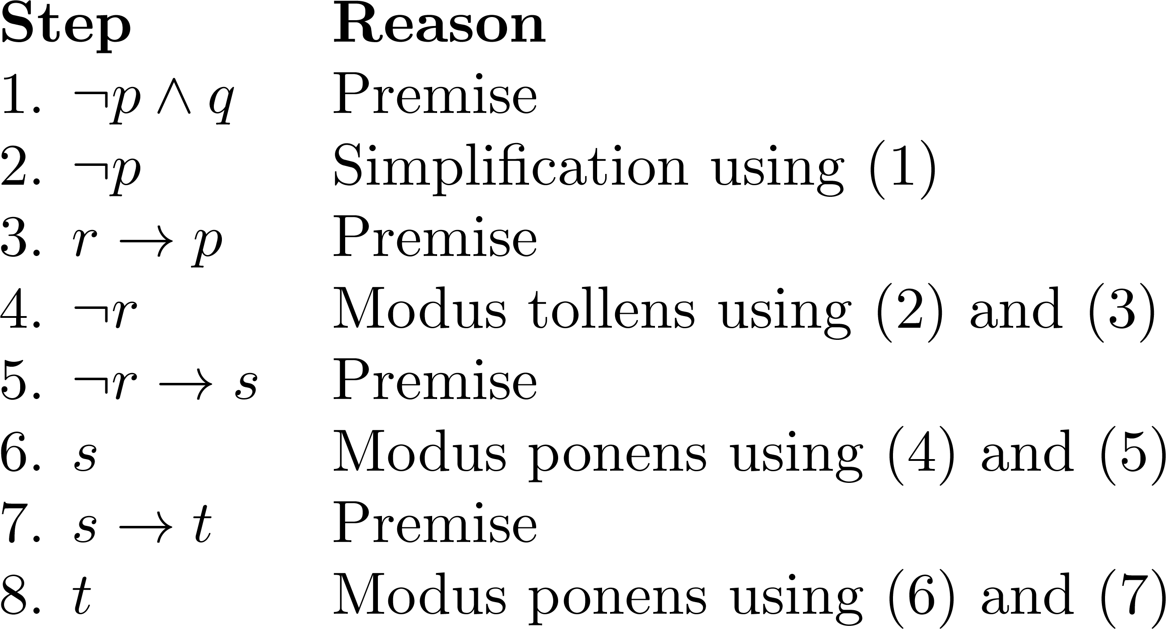

Slide 63
Section Summary
Mathematical Proofs
Forms of Theorems
Direct Proofs
Indirect Proofs
Proof of the Contrapositive
Proof by Contradiction

Slide 64
Proving Conditional Statements: p → q
Direct Proof: Assume that p is true. Use rules of inference, axioms, and logical equivalences to show that q must also be true.
Example: Give a direct proof of the theorem “If n is an odd integer, then n² is odd.”
Solution: Assume that n is odd. Then n = 2k + 1 for an integer k. Squaring both sides of the equation, we get:
n² = (2k + 1)² = 4k² + 4k +1 = 2(2k² + 2k) + 1= 2r + 1, which is odd,
where r = 2k² + 2k , an integer.
We have proved that if n is an odd integer, then n² is an odd integer.

Slide 65
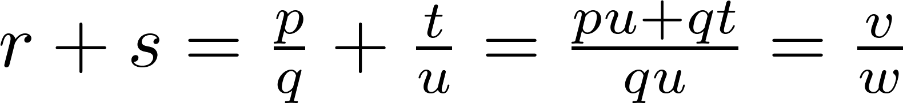
Definition: The real number r is rational if there exist integers p and q where q≠0 such that r = p/q
Example: Prove that the sum of two rational numbers is rational.
Solution: Assume r and s are two rational numbers. Then there must be integers p, q and also t, u such that
where v = pu + qt
w = qu ≠ 0
Thus the sum is rational.

Slide 66
Proof by Contraposition: Assume ¬q and show ¬p is true also. This is sometimes called an indirect proof method. If we give a direct proof of ¬q → ¬p then we have a proof of p → q.
Example: Prove that if n is an integer and 3n + 2 is odd, then n is odd.
Solution: Assume n is even. So, n = 2k for some integer k. Then,
3n + 2 = 3(2k) + 2 =6k +2 = 2(3k + 1) = 2j for j = 3k +1
Therefore 3n + 2 is even. Since we have shown ¬q → ¬p , p → q must hold as well.
If n is an integer and 3n + 2 is odd (not even) , then n is odd (not even).

Slide 67
Example: Prove that for an integer n, if n² is odd, then n is odd.
Solution: Use proof by contraposition. Assume n is even (i.e., not odd).
Therefore, there exists an integer k such that n = 2k. Hence,
n² = 4k² = 2 (2k²) and n² is even(i.e., not odd).
We have shown that if n is an even integer, then n² is even.
Therefore by contraposition, for an integer n, if n² is odd, then n is odd.

Slide 68
Trivial Proof: If we know q is true, then
p → q is true as well.
“If it is raining then 1=1.”
Vacuous Proof: If we know p is false then
p → q is true as well.
“If I am both rich and poor then 2 + 2 = 5.”
[ Even though these examples seem silly, both trivial and vacuous proofs are often used in mathematical induction, as we will see in Chapter 5) ]

Slide 69
Theorems that are Biconditional Statements
To prove a theorem that is a biconditional statement, that is, a statement of the form p ↔ q, we show that p → q and q →p are both true.
Example: Prove the theorem: “If n is an integer, then n is odd if and only if n² is odd.”
Solution: We have already shown (previous slides) that both p →q and q →p. Therefore we can conclude p ↔ q.
Sometimes iff is used as an abbreviation for “if an only if,” as in
“If n is an integer, then n is odd iif n² is odd.”

Slide 70
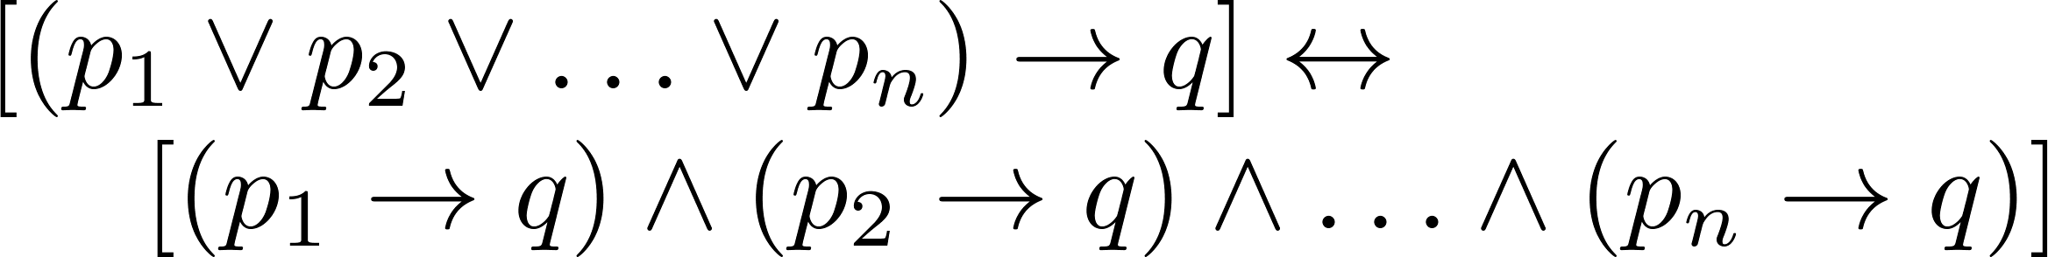

Proof by Cases
To prove a conditional statement of the form:
Use the tautology
Each of the implications is a case.

